Slide 2
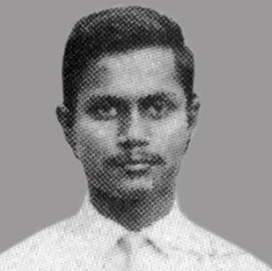
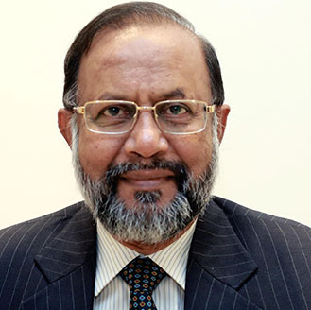
Amitabh Agrawal
“I was transformed from a young boy to an Electrical Engineer from the
portals of IIT. I learnt here human values, we lived as equals enjoying
whatever was given to us with no distinction between rich and poor
caste or creed. This helped me immensely in my life to forge everlasting relationships.”
Email: amitabh.agrawal@gmail.com

Slide 3
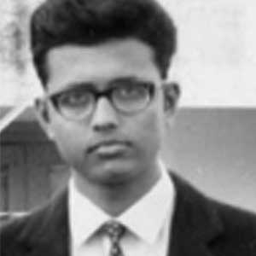
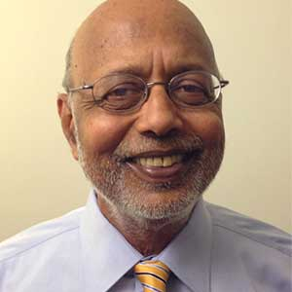
Amitav Rath
“Leaving home for Kharagpur in 1967 was the first step in a long journey of learning for me. It began with learning about amazing and diverse people and histories, with science and engineering, veering off to mathematics and economics, to rational decisions, and finally, to irrationality in the human condition.”
Email: amitavrath@gmail.com

Slide 4
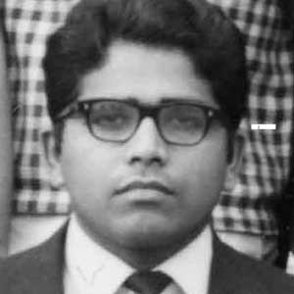
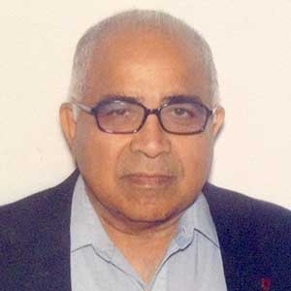
Anjan Bose
“Growing up among the steel mills of Burnpur, IIT was a sure ticket to a managerial job in one of the factories that dotted my horizon. Instead, this little rural campus gave me the confidence to explore the world.”
Email: bode@wsu.edu

Slide 5
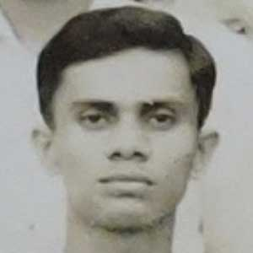
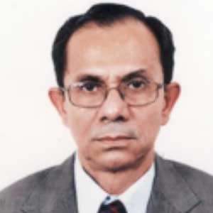
Asish Ray
“IIT changed me by teaching to adjust to a multicultural milieu. It ingrained in me the belief that there is always light at the end of a dark and intimidating tunnel and to cross it one has to use head and heart in equal measure.”
Email: akray45@gmail.com

Slide 6
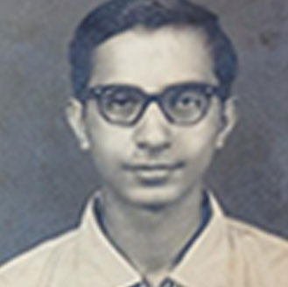
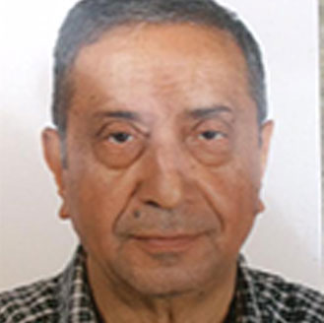
Ashok Kapur
“I was lacking in self-confidence and friends before coming to IIT. At IIT I gained in confidence and in friends and comradeship. Earlier I was fastidious about food. After IIT food was never a problem. IIT education literally opened the world for me, both mentally and physically. I became receptive to new ideas, new ways of thinking. It helped develop me as a person and hopefully a better human being. I am attaching a recent photo and old IIT identity card. I hope you can extract the photo from that.”
Email: akapur1945@yahoo.com

Slide 7
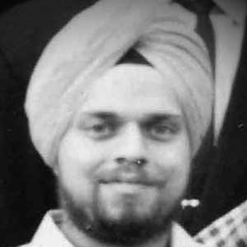
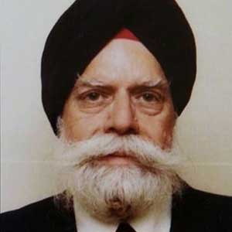
Ashok Singh
“It made me independent. I learnt to be tolerant. Found out that we eat to live. I was able to laugh at myself and make others laugh. Understood that the world is full of very talented people.”
Email: ashokabs@gmail.com

Slide 8
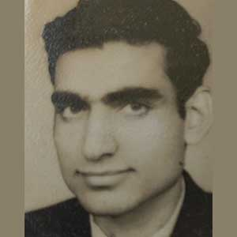
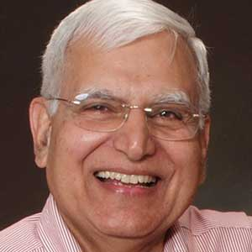
Avinash Taneja
“Started gaining sense of elation just by getting selected in IIT. Life in Campus atmosphere with smart guys all-around, taught me to keep adding value to myself. In outside world, and real life, unconsciously, I found myself able to manage any situations. I salute IIT .”
Email: avinash.taneja@hotmail.com

Slide 9
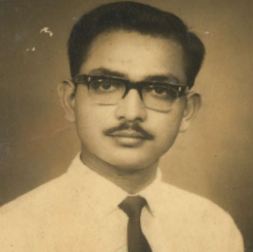
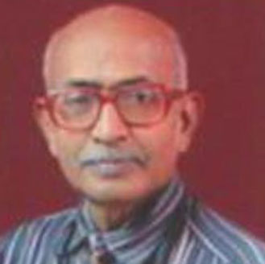
Bijay K. Sharma
“I completed my studies abroad and came back to India to work for making India rid of poverty and illiteracy. I dream of a SOCIALIST INDIA on the pattern Bernard Sanders dreams of USA and the way Jereme Corobyn dreams of United Kingdom”.
Email: electronics@nitp.ac.in

Slide 10
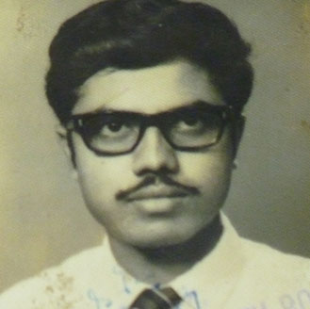
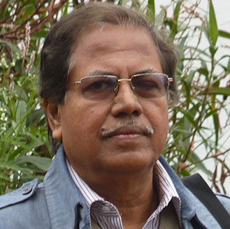
Biplab Dutta
“Coming from a small town in (erstwhile) Bihar, for a shy and diffident boy with schooling in a Bengali-medium but well-regarded school, and a delightful year at St. Xavier's Ranchi, the transition to the large, competitive and initially bewildering environment of IIT was a little painful at the outset, with some desultory grades in the first term, while things improved significantly soon, with some academic successes, great company of friends (cherish the delightful bicycle-rides to the Salua Air-Strip of WWII vintage!), many fine teachers, a great Library with a beautiful reading room and delightful Spring Festivals, the IIT experience changed the reticent boy to a well-rounded sensitive young man, confident to embark on new vistas in India and abroad.”
Email: biplaby2k@hotmail.com

Slide 11
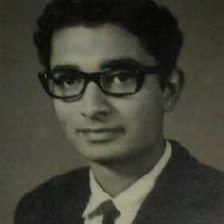
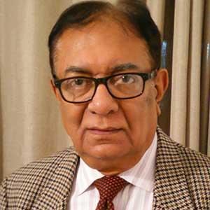
Bireswar Mitra
“IIT KGP opened up the world to a small town boy like me. I learnt that a good set of friends is fundamental to intellectual growth. Friends made here are for life, and have had a tremendous impact on life. Classroom learning is only a small part of the gifts that were imparted: you learned how to socialize, live independently, manage your budget, deal with debt, prioritize, manage your time, and have a good time with great friends. IIT taught me that life was much more than just about the academics. It prepares you to face the challenges of life with Courage, Conviction and Commitment.”
Email: biresh_mitra@yahoo.com

Slide 12
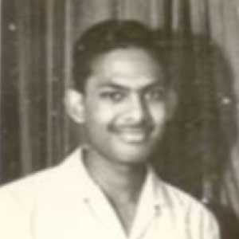
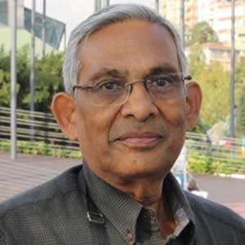
Chand Tulsian
“IIT helped me to appreciate differences, equality, merit and forge friendships. IIT enabled me to discuss issues and to find solutions. I learnt that a smile and humour is a great help to resolve conflict between heart and head.”
Email: tulsianc@gmail.com

Slide 13
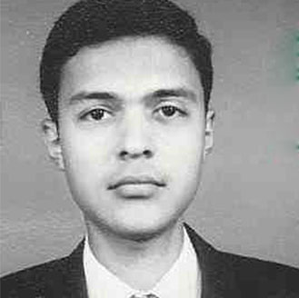
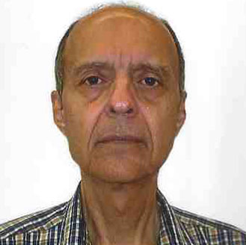
Darius Tanksalvala
“IIT provided me a solid technical foundation which gave me the skills and qualifications to pursue the career of my choice. For the first time I met students from all over India, and some of them have become lifelong friends-even though we live far apart.”
Email: tanksalvala@yahoo.com

Slide 14
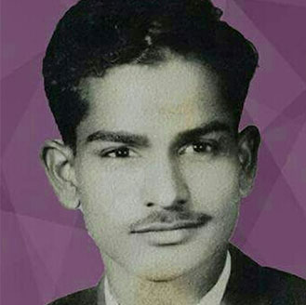
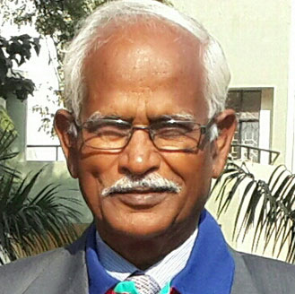
Devi Singh Rajput
“To read at IIT Kharagpur was the most exciting and unforgettable. Two years of study made tremendous change in me and it helped complete my Master of Technology. I gained deeper knowledge, expertise and confidence to serve the Nation. Being son of a farmer it was doubly fascinating to acquire the Degree in Agricultural Engineering.”
Email: dsrajput45@gmail.com

Slide 15
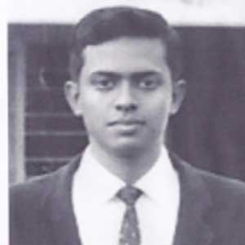
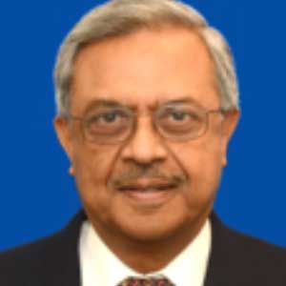
Dipak Majumdar
“The Kharagpur IIT experience transformed me from a boy growing up in a sheltered environment, to an adult equipped with a competitive spirit developed in a very competitive environment, and a "can do" attitude ready to take on life's challenges. I must also mention memories of the comraderie and life-long friendships that were developed.”
Email: dipakmaj1@hotmail.com

Slide 16
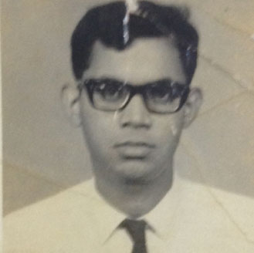
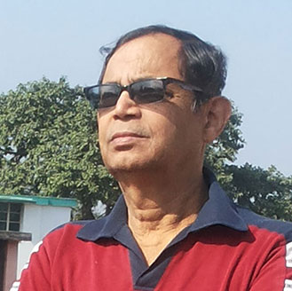
Dipak Sanyal
“The magic of IIT is its smooth & seamless blending of the curriculum with personality development (PD). PD is not taught here in classes. It is radiating in the air, all pervasive & mesmeric. You just absorb the same from your teachers/seniors/peers, efflorescencing your unique brand. Before you realize, the Ugly Duckling has matured into a majestic swan. ”
Email: dipak_sanyal@yahoo.co.in

Slide 17
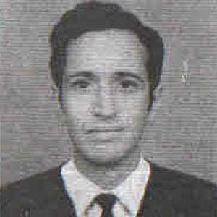
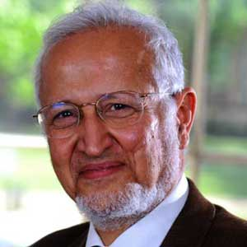
Farrokh Mistree
“In retrospect at IIT KGP I learned to challenge conventional wisdom by asking questions, reflecting and arriving at conclusions worthy of investigation, and most importantly I became aware that I enjoyed helping others grow through learning. Hence, the mantra: Being a professor is the best job in the world. The only thing better than that is being married to one!”
Email: farrokh.mistree@ou.edu

Slide 18
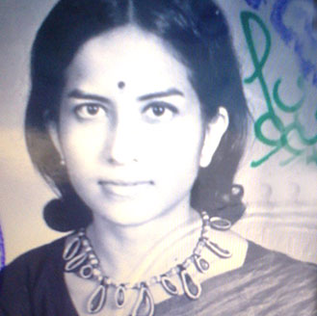
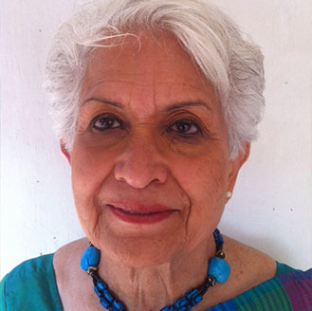
Hansa Nundy
“Being the "one of a kind" in my class compelled me to introspect and recognize the need to satisfy my social and humanitarian consciousness. After 25 years as an Electronics Engineer in Canada,in 1993 IIT facilitated my transition into becoming a Social Worker in India by helping me to set up the Seema Centre within IIT, for providing underprivileged children the life skills required to live their lives with dignity. I treaded on the path I charted for myself even if it meant walking on it all alone. "Akla chole re”.
Email: nundyhansa@hotmail.com

Slide 19
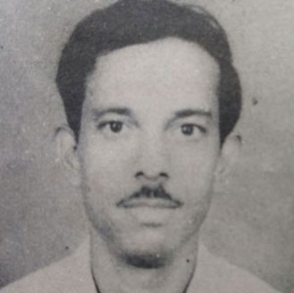
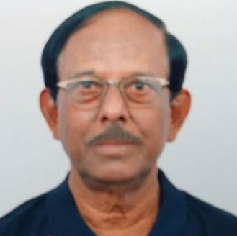
Narayan Dutta
“Unity in diversity was learned and practiced at IIT. Initially we were all from different regions of the country with different cultures, economical background, social status with different mother tongue. But when came out of IIT after 5- yrs. we couldn't realised our gradual changes. However all of us were out as IITians forgetting our past identity. Discipline was main arm with knowledge for us to raise in the helm of business/education/Technical spheres or any other fields. We learned to win unknown and to make impossible to possible.
I salute IIT- KGP. Jai Hind ! Bande Mataram....”
Email: nd.techindia@gmail.com

Slide 20
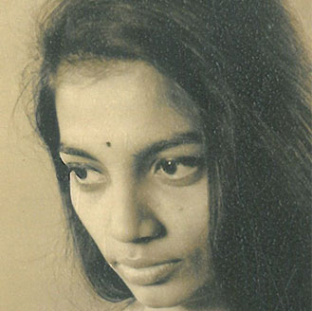
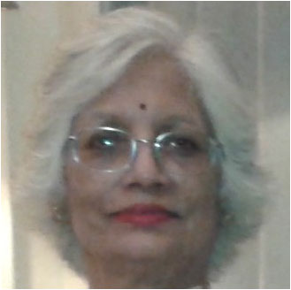
Neeta Sharma
“IIT Kgp changed my life by exposing me to varied ideas & concepts at times diametrically opposite.
Taught me to analyse and conceptualize - to DESIGN MY OWN LIFE.
Add to that the lasting Bond & Inspiring Batch-mates, so well reflected in the recent Golden Jubilee Reunion.
For me IIT is an ONGOING PROCESS.”
Email: neetasamir@gmail.com

Slide 21
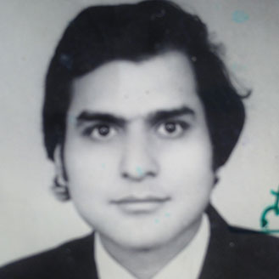
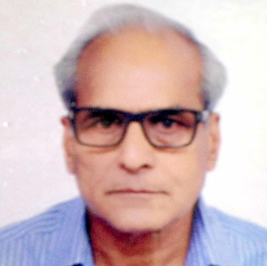
P S Agarwal
“Coming to IIT gave a new prospective to my life. Not only it nurtured my technical abilities to be a successful Engineer but also taught me various life skills. Coming out from comfort and love of home, to learn with people from all over the country as batch mates in itself was an experience. The excellent facilitation from professors helped me train to deal with corporate and life pressure which are inevitable in everyone's lives including me. My personality got a complete evolvement through a culture of learning and progressiveness.”
Email: psagarwal1946@gmail.com

Slide 22
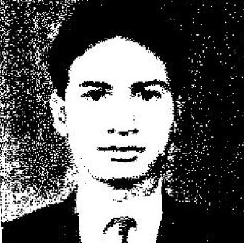
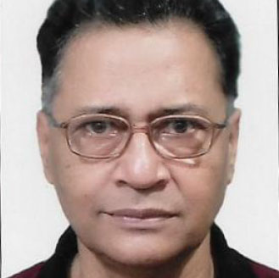
Prabir G. Thakurta
“IIT changed me by teaching how to face the challenges in life with passion and compassion and the basics of entrepreneurship and innovation.”
Email: hydrolub@vsnl.com

Slide 23
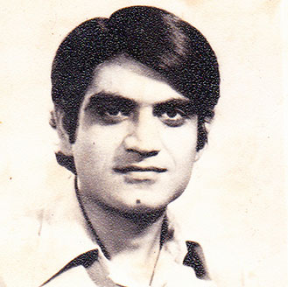
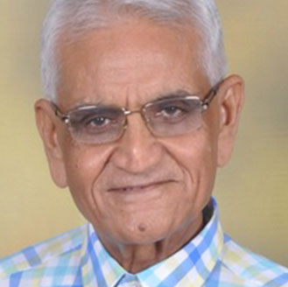
Premsagar Chhabra
“To my mind, the best thing that IIT provided was perhaps the coming together of the intellectual capital of the country, growing in knowledge & intellect year after year, eventually leading to the creation & growth of ‘Brand IIT’ through the subsequent deeds & accomplishments of Alumni in the Professional World. There remains the challenge of taking initiatives in the turnaround of psychological mind sets, which are at the root of conflict, division in the society; leading to wars, terrorism, poverty & ultimately continued threat to peace. Remember, someone having stated rightly that “Not everything that is faced can be changed but nothing can be changed unless it is faced”.
Email: tmssvadodara@gmail.com

Slide 24
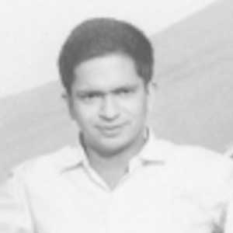
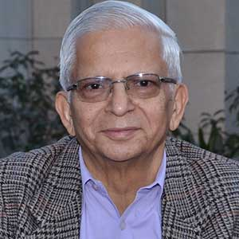
R. K. Caprihan
“IIT brought a spoilt lad like me down to earth; ready to face the world. Like a boxer I could get knocked, yet rise again; made me accept and respect people from all walks of life and differentiate good from the bad Thank you, IIT Kharagpur.”
Email: rk@caprihan.com

Slide 25
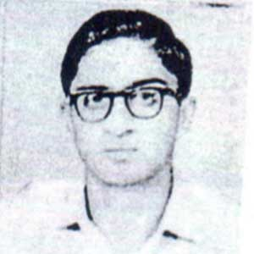
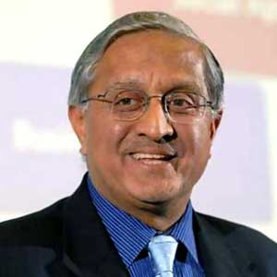
R. Gopalakrishnan
“IIT changed me by teaching me the essence of leadership: the difference between between technology and human relationship, between intellect and heart, between smart and effective leaders. Huge deal.”
Email: rgopal@themindworks.me

Slide 26
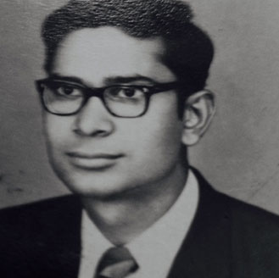
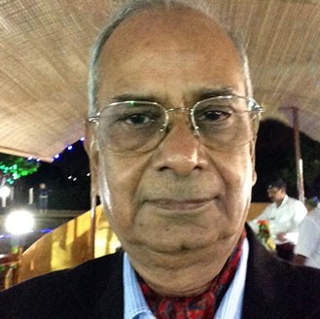
Rakesh Varma
“Coming to IIT gave a new prospective to my life. Not only it nurtured my technical abilities to be a successful Engineer but also taught me various life skills. Coming out from comfort and love of home, to learn with people from all over the country as batch mates in itself was an experience. The excellent facilitation from professors helped me train to deal with corporate and life pressure which are inevitable in everyone's lives including me. My personality got a complete evolvement through a culture of learning and progressiveness.”
Email: rakeshbverma45@gmail.com

Slide 27
Ram L Garg
“Electrification of my village in 1958 decided my future. With this goal in mind, I managed to get into IIT KGP EE. Hats off to my Alma Mater that transformed brass in me to Gold and I, enthusiastically, joined and played a leading role of a “Practical and Committed Chartered Engineer” in the Intra and inter-national Power Industry.”
Email: engineergarg@yahoo.com.au

Slide 28
Ram Khurana
“It opened up the world of opportunities.”
Email: ramkhurana@hotmail.com

Slide 29
Ravinder Bhatia
“How so ever , deprived / underprivileged one may be, IIT teaches and-provides ways and means and opportunities to achieve one's dreams.”
Email: ravinder_bhatia@hotmail.com

Slide 30
S. Murali Kumar
“The accidental IITian: Although my decision to write the test was an accident, IIT has prepared me for the journey of life. The baptism by fire has given me the ability to attack problems with tenacity till practical solutions are reached either by design or even by 'Jugaad’. ”
Email: siruguri2001@gmail.com

Slide 31
S V Singh
“During my iit days I learnt the art of pretending to be busy while remaining to be easy. This trait was of great help in my transition from architecture to banking & now to farming. A very enjoyable journey.”
Email: svsingh35@gmail.com

Slide 32
S. Visweshwaran
“When I came to Kharagpur, I suddenly found myself in the midst of students who were lot brighter and smarter than me. Thanks to IIT, their smartness and brightness rubbed off a little on me which has helped later in life.”
Email: svishu@gmail.com

Slide 33
Sahab Saran
“IIT strengthened my scientific & technology based understanding of the surroundings and prepared me to face the world. In addition, it help me to learn time management for completion of tasks against very tight time schedules, while enjoying camaraderie.”
Email: saransahab@hotmail.com

Slide 34
Samir Sharma
“Being holed up for good five years in IIT (Kgp) among the brightest chaps gave me all I could desire for. Concepts like 'So What', 'Mast Raho' has given this diminutive 5'-5.75" person the confidence of standing among the tallest and remain comfortable. The signature image of half-towel clad genius reciting 'Shakespeare' verbatim eggs me on to keep striving for nothing else but 'Excellence'.”
Email: samirneeta@gmail.com

Slide 35
Satish Sud
“IIT really changed and set the direction of where we are today. IIT provided the basic foundation on which I was able to build an International career. IIT as the starting point gave credibility to our credentials and from there it was possible with hard work to follow and achieve our ambitions.”
Email: satish_sud@hotmail.com

Slide 36
Satya Narain Pasari
“Coming from business community to IIT KGP in 1962 was very significant.My years at IIT were very productive and informative. The best part was to proceed in life with confidence and self discipline after graduation.Going To IIT after 50 years had been very enjoying and fulfilling experience.”
Email: rohitchem@rediffmail.com

Slide 37
Shankar Mukherjee
“Till age sixteen, I grew up in Kolkata amidst Bengali customs and traditions. I went beyond Bengal when I entered IIT, Kharagpur, where students from all corners of India congregated. IIT taught me cosmopolitanism, which has stayed with me ever since.”
Email: mukherjee.shankar@gmail.com

Slide 38
Subendhu Chaudhuri
“I had the audacity of not applying for any entrance examination other than IIT . Getting an admission there was a momentous achievement to my family and friends . But landing there with high hopes and aspirations was not that smooth sailing , we were so much vulnerable coming from vernacular schooling background . Starting from a reasonably high standard gradually slipped down the merit list and that dented the usual confidence . Though I finished with a upper class degree , I felt how insignificant I am compared to the vast majority of the highly successful students around . A microscope enlarges a tiny object to a huge size , the IIT acts in my case as a reverse microscope . As my fellow students speak now of their achievements , I feel I am not wrong in my assessment.”
Email: subendhu2k5@gmail.com

Slide 39
Subhasis Chakrabarti
“The multilingual & multicultural atmosphere within the campus and the influence of some of the best teaching brains in the country had a profound effect on a vernacular school educated small town boy. Apart from studies, the various activities in the campus made me learn about teamwork, collaboration and leadership. IIT made me fighting fit to face the challenges of professional life.”
Email: chakrabarti.subhasis@gmail.com

Slide 40
Surajit Dutta
“Learning at IIT-KGP, Technology along with Humanities components had shaped my understanding and appreciation of technology application under challenging man - machine environment to lead and manage the corporate goals.”
Email: surajitdutta@hotmail.com

Slide 41
Surendra Handa
“It was like a frog from a well has been put in an ocean. The years spent in IIT instilled self-confidence. Bond of friendship with alumni taught me the values of lasting relations based on equality. I salute the dedication of faculty that played invaluable role in my understanding engineering fundamentals. IIT opened a flood gate of opportunities.
I wish I could do much more to pay back to IIT.”
Email: handask73@gmail.com

Slide 42
V S Modi
“Understanding and feeling Democracy is the most important contribution from the campus life for me. No where else would have I come across such a large assemblage of wide variety of personalities. It also gave me the live practice as how to survive with the meager resources.”
Email: vsmodi@ymail.com

Slide 43
Ved P. Gupta
“IIT changed me by showing me how to live and work with a diverse group of people. This is where I learned the fundamentals of technical and leadership skills. I owe my success in life to IIT.”
Email: vedpgupta@gmail.com

Slide 44
Ved Prakash Sandlas
“IIT made me appreciate differences between Physics, Engineering and Technology, and their practical integration. VS Hall stay made me independent and confident by an order of magnitude. IIT initiated me into Ham Radio making me visible and grow internationally.”
Email: vpsandlas@gmail.com

Slide 45
Vijay Kiyawat
“IIT professors, its teaching facilities, and diverse student population from across the country taught me technical and social skills to face the world boldly. Brand IIT opened gates for me in life and changed my fortunes. Great initiative indeed. Thanks.”
Email: vijaykiyawat@gmail.com

Slide 46
Vijay Sardana
“IIT built my foundation for self esteem, dignity of labour, empathy, service above self and humility.”
Email: vjsardana@hotmail.com

Slide 47
Vinod Chachra
“First, at IIT, I learned to be a good engineer. Second, I learned the value of open spaces, of lasting friendships, of collaboration and of teamwork. Third, standing alone, late at night, in my balcony at RK Hall, I learned the art of self-reflection. I learned to observe, to listen, to question and to reflect. Over time this gave me the confidence to deal with the unknown and the unexpected.”
Email: vinod.chachra@gmail.com

Slide 48
Vinod Dang
“Hailing from a small town in Punjab,IIT opened my doors to the world. Interacting with best of the intellectuals from around the country changed my perspective towards learning and social interactions,helping me chart life and career for the past 50 years.”
Email: dangvk@yahoo.com

Slide 49
Vinod Gupta
“Coming from a village , I realized how big India is--different languages and food but all Indians. I learnt about friendships, camaraderie and social skills, which brought me success... otherwise I might be selling vegetables in my village!”
Email: vin@vingupta.com

Slide 50
Vinod Sobti
“The IIT years robbed me of my YOUTH. The 5 years were like being in a GURUKUL.
But in return I got FUNDA, FRIENDSHIPS, and TEMPO which stood me in good stead for rest of my life.
The diversity of campus and rustic life shaped me into " A man for all Seasons " with zest for DIL MAANGE MORE !”
Email: vsobti@yahoo.com

Slide 51
Y P Gulati
“The important lessons I learnt at IIT
1. “Fundas must be clear” - from my seniors (during ragging)
so from day one I made sure that I had fully understood whatever was taught
2. “Education is a foundation and no knowledge is wasted”
3. “Happiness is based on sound long-lasting interpersonal relationships”
IIT thus prepared me for the challenges of real life situations and I was able to face them successfully and retain my sanity based and these principles.”
Email: gulati@asia.com

